Slide 1
Chameleon Service Training
Dieburg, 06.-10.06.2016
Laser System Overview

Slide 2
Overview
Company Coherent
Chameleon Laser System Overview
In-House versus Field Service

Slide 3
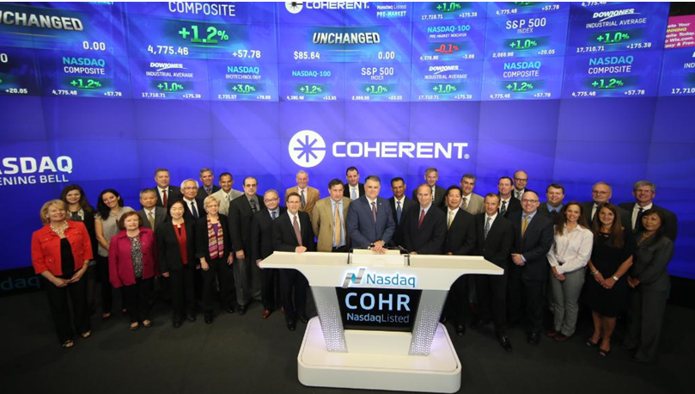
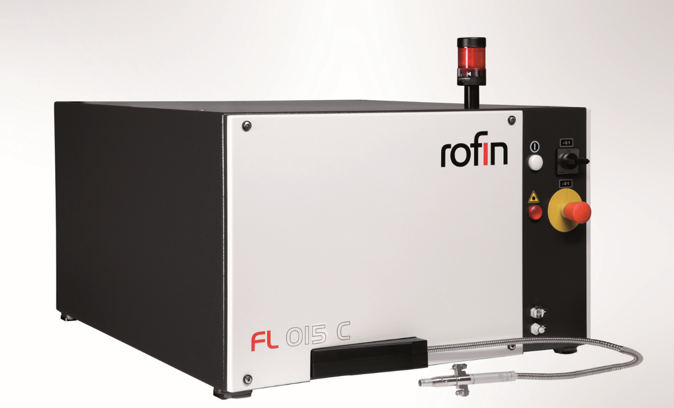

Coherent – The Laser Company
“Founded in 1966, Coherent, Inc. is one of the world's leading providers of lasers and laser-based solutions for scientific, commercial and industrial customers competing in the most demanding markets.”
Currently more than 2300 employees, whereas 250 working in service
Coherent is quoted on the stock exchange (Coherent Inc.)
This year has several companies highlights:
50th year anniversary
Coherent to aquire Rofin Sinar (2270 employees)

Slide 4
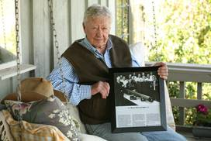
Coherent – The Founder
The idea of the start-up company that became Coherent Radiation Laboratories (now Coherent) was stimulated in 1965 by the unwillingness of Spectra-Physics management to develop gas-ion laser products. As manager of sales and marketing at Spectra-Physics, I was aware of the growing demand for continuous-wave lasers producing more power and shorter wavelengths than was possible with the HeNe lasers that had propelled Spectra-Physics into leadership of the emerging laser industry…….
Eugene Watson

Slide 5
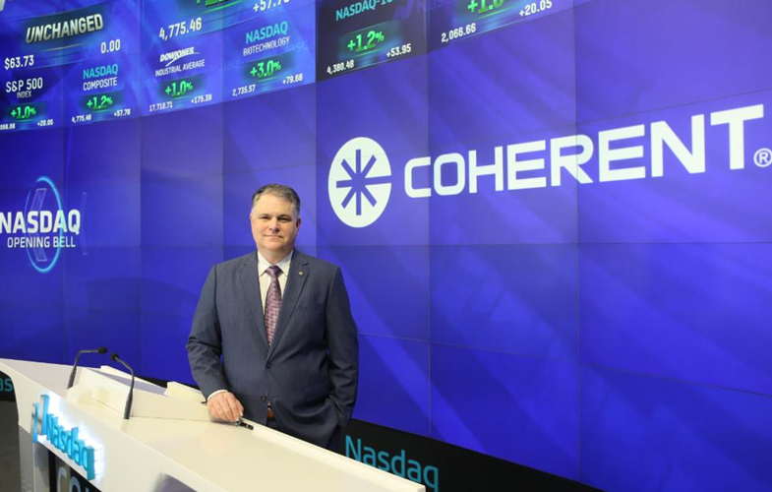
Coherent – Our CEO
John Ambroseo

Slide 6
E-Mail from John, 26.05.2016:
Fifty years ago today, our company got its start in a laundry room in Palo Alto, California when our founders decided to break new ground in a very, very young laser industry. We have had our share of tremendous successes over five decades as well as some spectacular failures. There have been several constants throughout including our desire and commitment to innovation, an ethos of customer care, truly exceptional customer relationships some of which have spanned decades and, most importantly, extraordinarily dedicated colleagues both past and present. Perhaps the most amazing part of this story is that Coherent is setting new records at a point its history when other companies are struggling to remain relevant. We have much to celebrate and much more to do.
Congratulations and thank you.
With kind regards,
John Ambroseo President and Chief Executive Officer

Slide 7
50th anniversary video

Slide 8
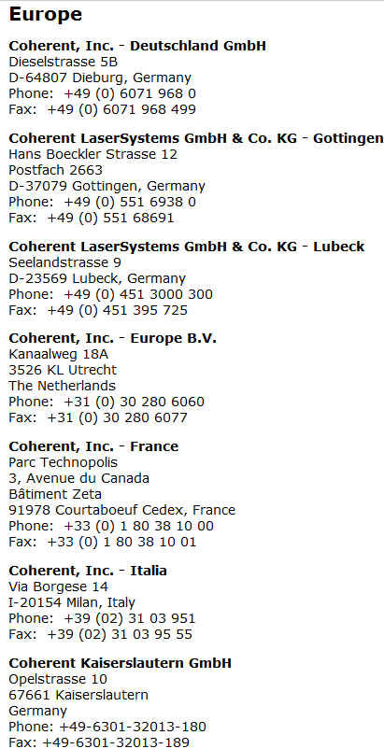
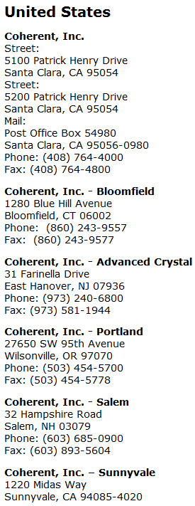
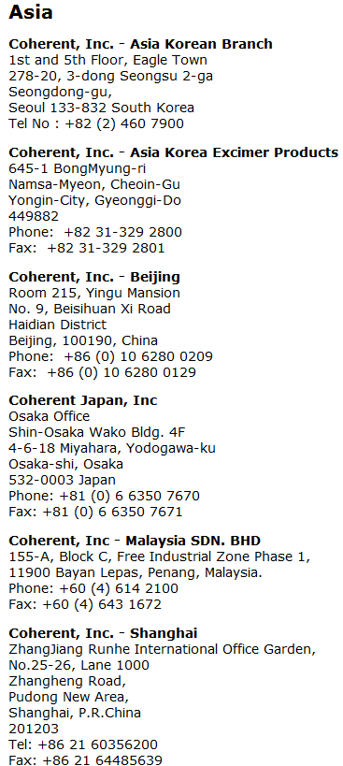
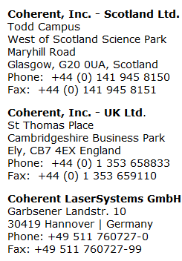
Coherent – The Headquarter & Subsidiaries
Headquarter: CA, Santa Clara

Slide 9
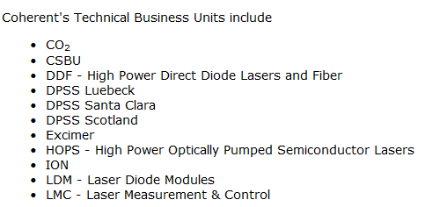
Technical Departments

Slide 10
German Subsidiaries
Dieburg: Sales & Service
Göttingen (Excimer Laser)
Lübeck (Diodelaser)
Kaiserlautern (UV Laser, pulsed)
APE Berlin (Independent)

Slide 11
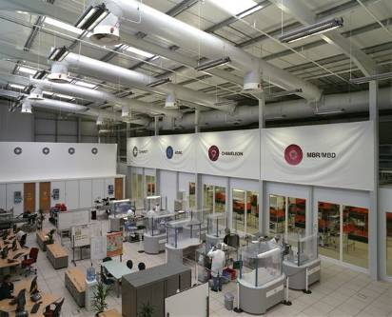
Glasgow Factory
Chameleon Product Family
MBR/MBD
Rapid NX
Azure
Mephisto / Prometheus
…

Slide 12
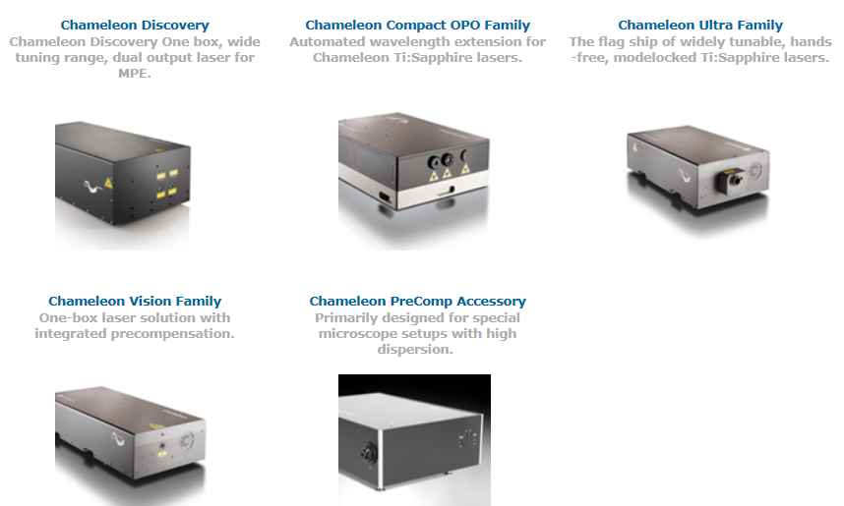
Chameleon Laser System Overview

Slide 13
Chameleon Laser Applications
Multiphoton Excitation / Microscopy
Second Harmonic Generation Imaging
Third Harmonic Generation Imaging
• CARS/SRS Microscopy
Optogenetics
Ultrafast Spectroscopy
Non-linear Optics
OPO pumping

Slide 14
Chameleon Laser System Overview
Laser Head
Power Supply Unit (PSU)
Chiller
MRU

Slide 15
Chameleon Laser System
Closed-loop mini re-circulator dries & filters air for tuning >920 nm w/oxternal purge
Verdi 18W Pump Laser
MRU
Power Supply
Chiller
Verdi Pump
Ultrafast Cavity
Rack mount; menu- or RS232-driven
Sealed KLM Ti:S cavity & Verdi™; onboard spectrometer

Slide 16
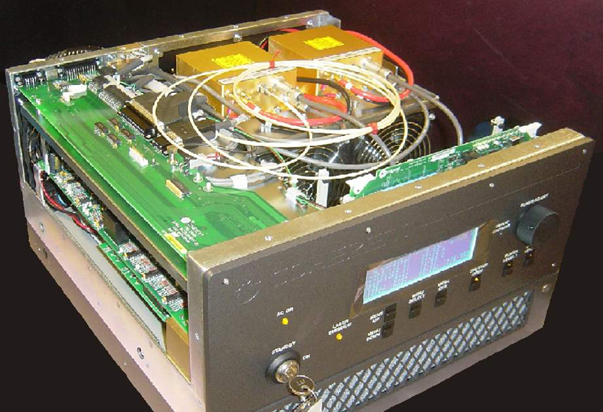
Power Supply Unit (PSU)

Slide 17
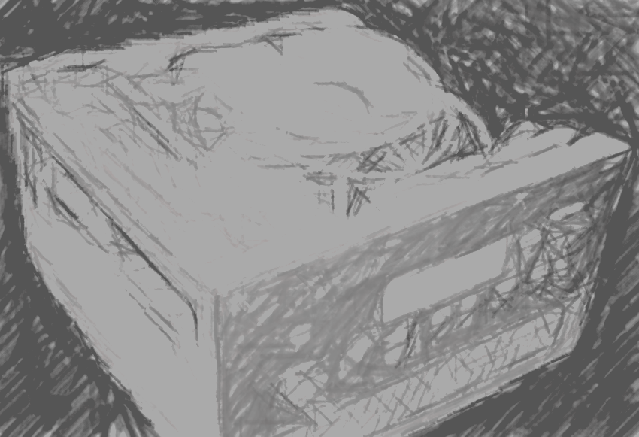
Power Supply Unit (PSU) contains
Power Supply, 1000W, 85-265VAC, 48V, 21A
Power Distribution PCBA
Signal Interconnect PCBA
CPU Board
Mother Board
VAN 2 Board
Chameleon Interface Board
Front Panel
Two FAPIs

Slide 18
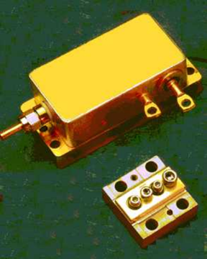
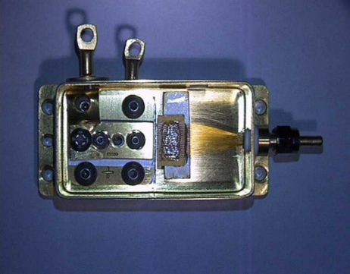
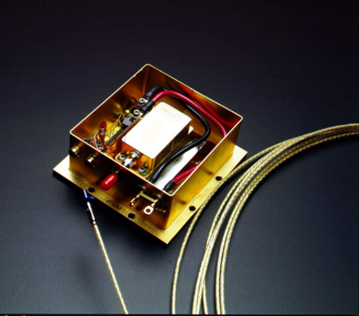
Fiber Array Package Integrated (FAPI)

Slide 19
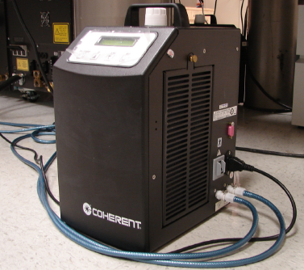
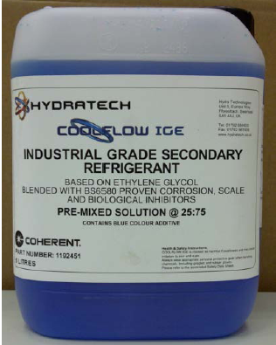
Chameleon (& Verdi) Chiller
For cooling down Ti:Sa crystal & Verdi baseplate
new cooling fluid: CoolFlow IGE (based on Ethylene Glycol)
Service Accessoires:
Flow sensor
Pressure pump
Inline Filter
CPC Fittings

Slide 20
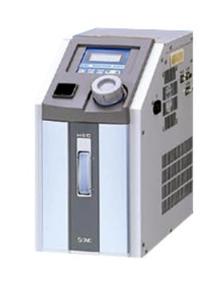
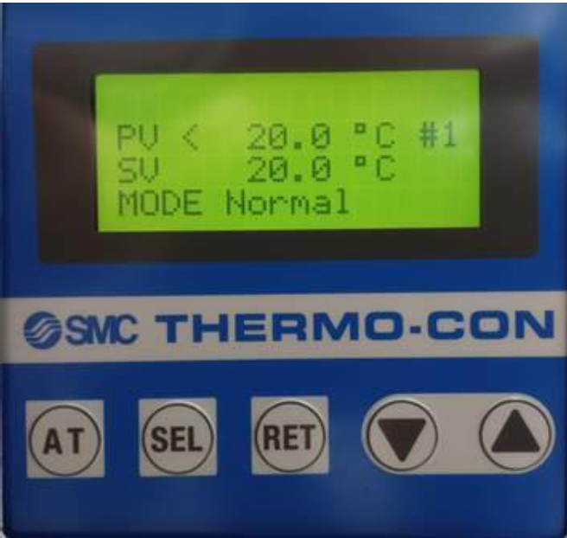
new Chameleon Chiller: SMC HEC002
FSB 796
New orders: only SMC chillers shipment
PN #1306184

Slide 21
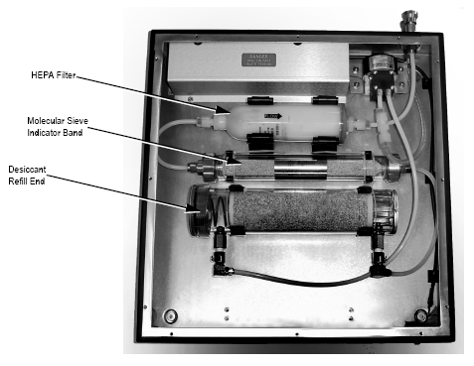
Miniature Recirculation Unit (MRU)
small, peristaltic air pump (air circulation)
Molecular sieve (absorbs gas, steam and solutes)
HEPA (High Efficiency Particulate Airfilter)
Dying agent “Dririte”

Slide 22
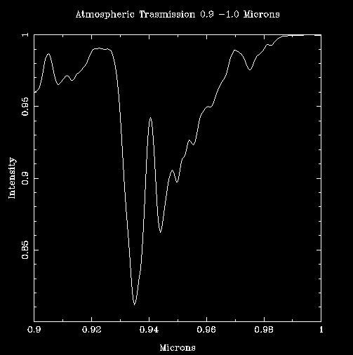
Function of MRU
Athmospheric absorption of light
KLM needs 0-3% humidity
935nm strongest absorption peak
Test function of MRU
@ 920-940nm

Slide 23
Glasgow Factory

Slide 24
Glasgow Factory: In-house Tests
Slogan: Superior Performance & Reliability
HALT/HASS: Highly Accelerated Life Test / Stress Screen
Random vibration tests – 10min @ 5g’s, 5min @ 10g’s!
-40 to +60 °C thermal cycling (5.5 cycles, 2 hours/level)
Another vibration test.
Simulates a 3000 mile ride in a flatbed truck
First Chameleon in installed in Antarctica!

Slide 25
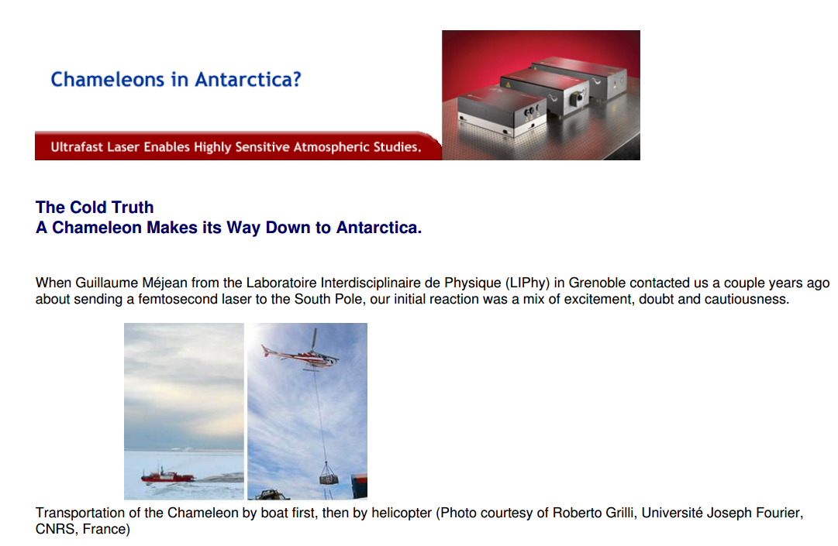

Slide 26
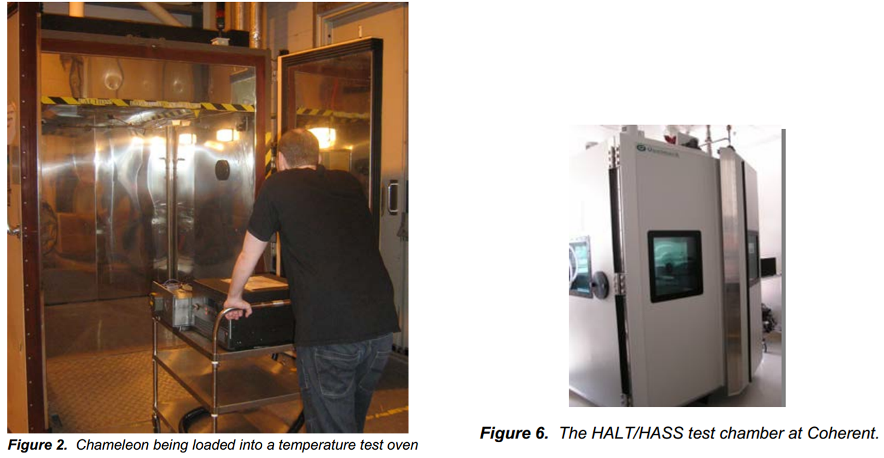
In-house Test Procedures

Slide 27
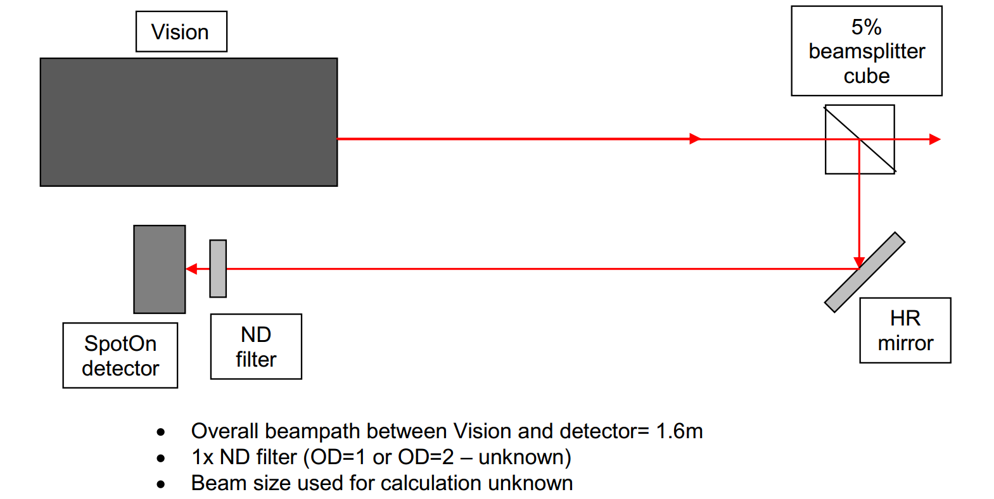
Further In-house Test Procedures
Pointing Measurements:

Slide 28
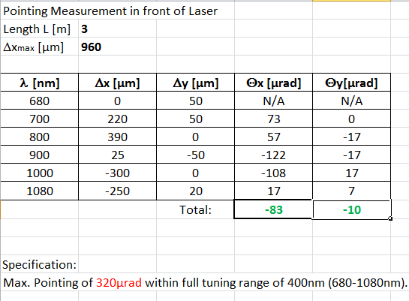
Further In-house Test Procedures
Pointing Messung:

Slide 29
In-house Tests
Further Procedures to come…

Slide 30
Field Service
Remote Session for Evaluation & Optimization
On site: Calibration of i.e.
Photocells
Pump Power Level
Wavelength
Optimization of temperatures
Measurement of Beam Parameters
Cleaning of optics (limited)
Replacement of electronic boards, FAPIs, shutter, etc.
Customer Care !!

Slide 31
Depot Repair
Pump-Laser Replacement
Ti:Sa Resonator Repair
Only to be opened in clean room conditions @ Glasgow Factory!

Slide 32
